Slide 1

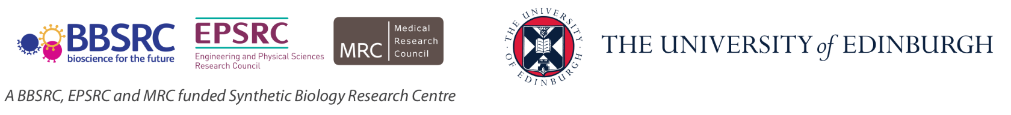
Biological Research
Data Management Team
SBS PhD Induction Dealing with data
Dr Livia Scorza
bio_rdm@ed.ac.uk

Slide 2
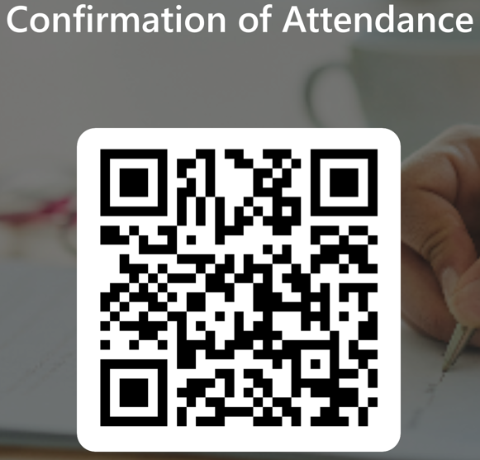
https://forms.office.com/e/Pb0Dx6H4YL

Slide 3
Course Content
Open Science and FAIR Principles
Organising and Documenting Your Data
Introduction to metadata
Electronic Lab notebooks
Working with files
Introduction to Data Management Planning
Active Data Storage
Data-related resources at the University (UoE Digital Research Services team)
https://pad.carpentries.org/2024-11-06-PhD_Induction-BioRDM
Notes:
Alternative to learning objectives

Slide 4
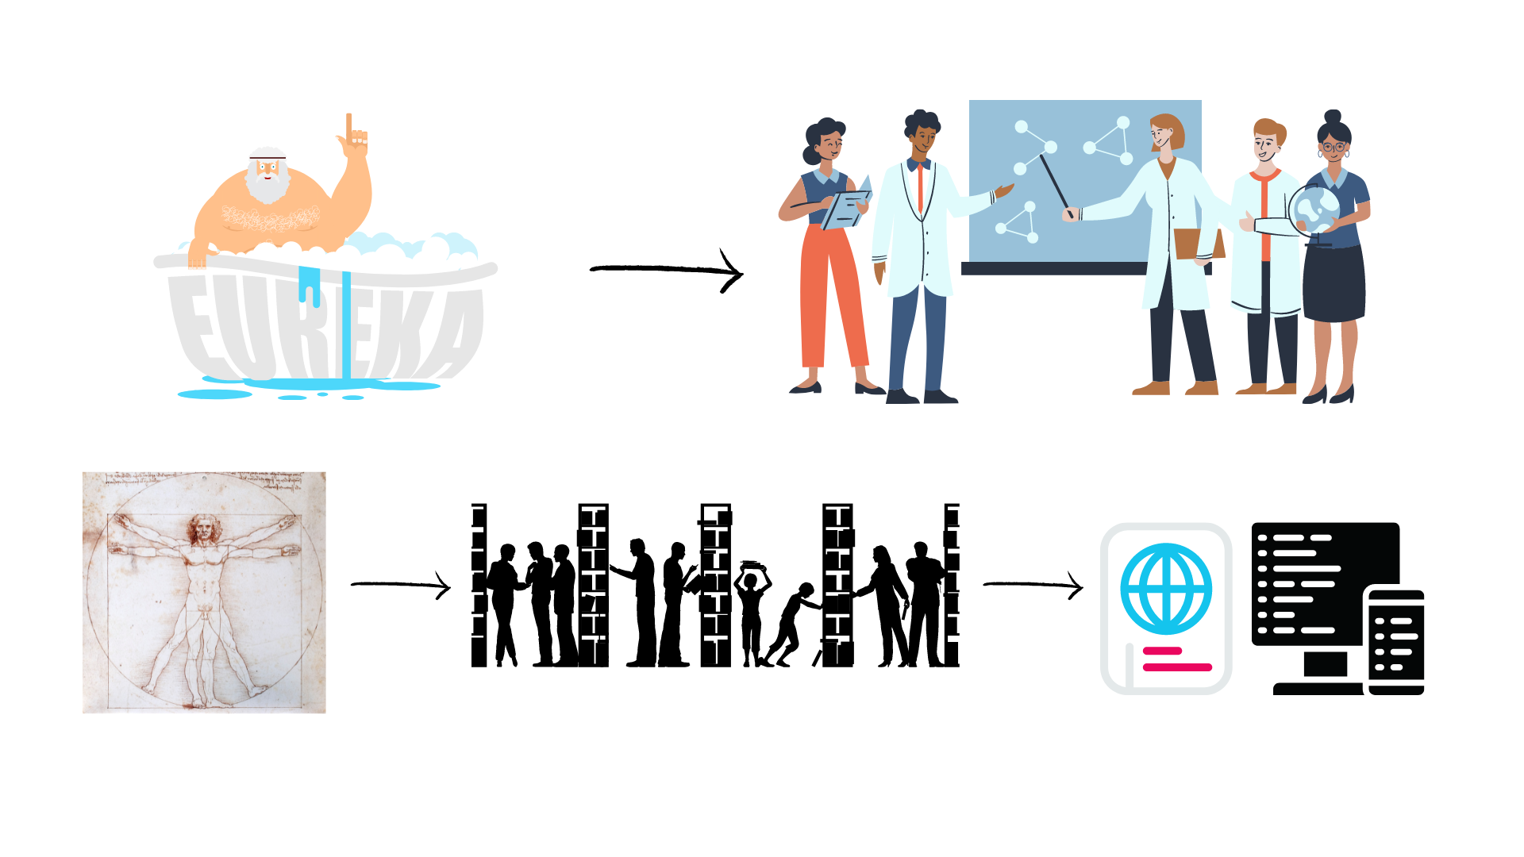
Evolution of Open Science
Level of openness in research

Slide 5

Open Science
Open science is transparent and accessible knowledge
that is shared and developed
through collaborative networks.

Slide 6






Open Science
Open science is the movement to make scientific research accessible to all levels of society
general public
amateurs
professionals
students
teachers
publications
data
physical samples
software
Digital technologies for diffusing knowledge

Slide 7
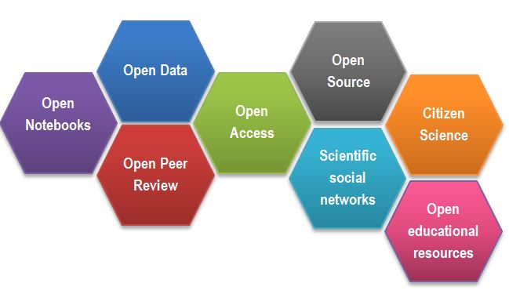
Open Science
CREDITS Open Science facets as a beehive by Gema Bueno de la Fuente licenced under CC-BY
Notes:
Open methodology: open notebooks, open software source code, data; open access (anyone can read and download content without fees or paywalls), Scientific social networks play a key role in open science by facilitating collaboration, sharing, and communication, citizen science – possibility of non-professionals to contribute to data collection, analys, etc. Open educational resources.

Slide 8
Outcomes of Openness
Collaboration
Speed
Unpulished / negative results
Re-use
Learn by example
Feedback

Slide 9
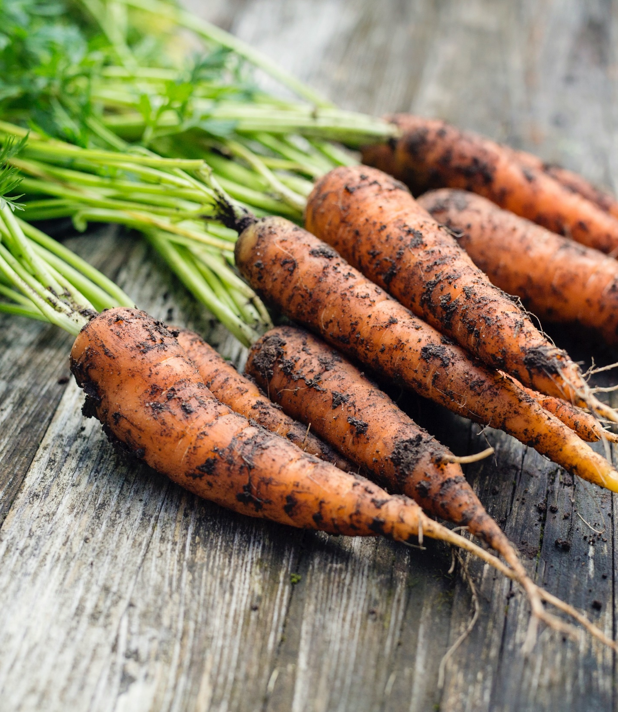
Motivation
“stick”
Large UK funding bodies such as The Wellcome Trust and UKRI require funded research to be open access
“carrot”
….

Slide 10
Your motivators
Exercise 1

Slide 11
But how (not) to share in practice

Slide 12
Data from publications
…

Slide 13
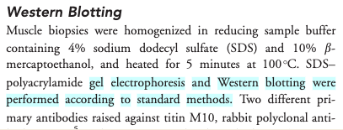
Impossible protocol

Slide 14
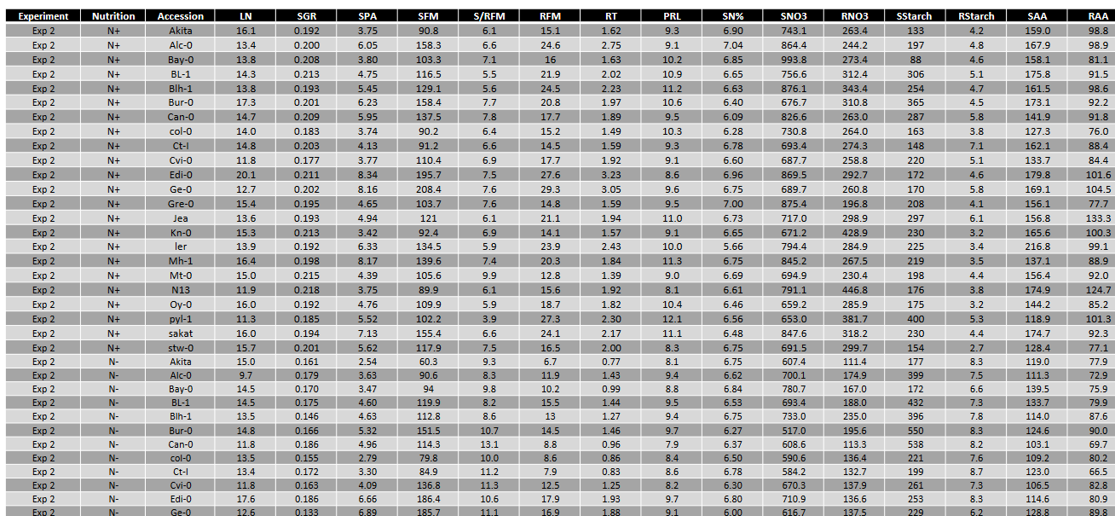
Impossible average

Slide 15
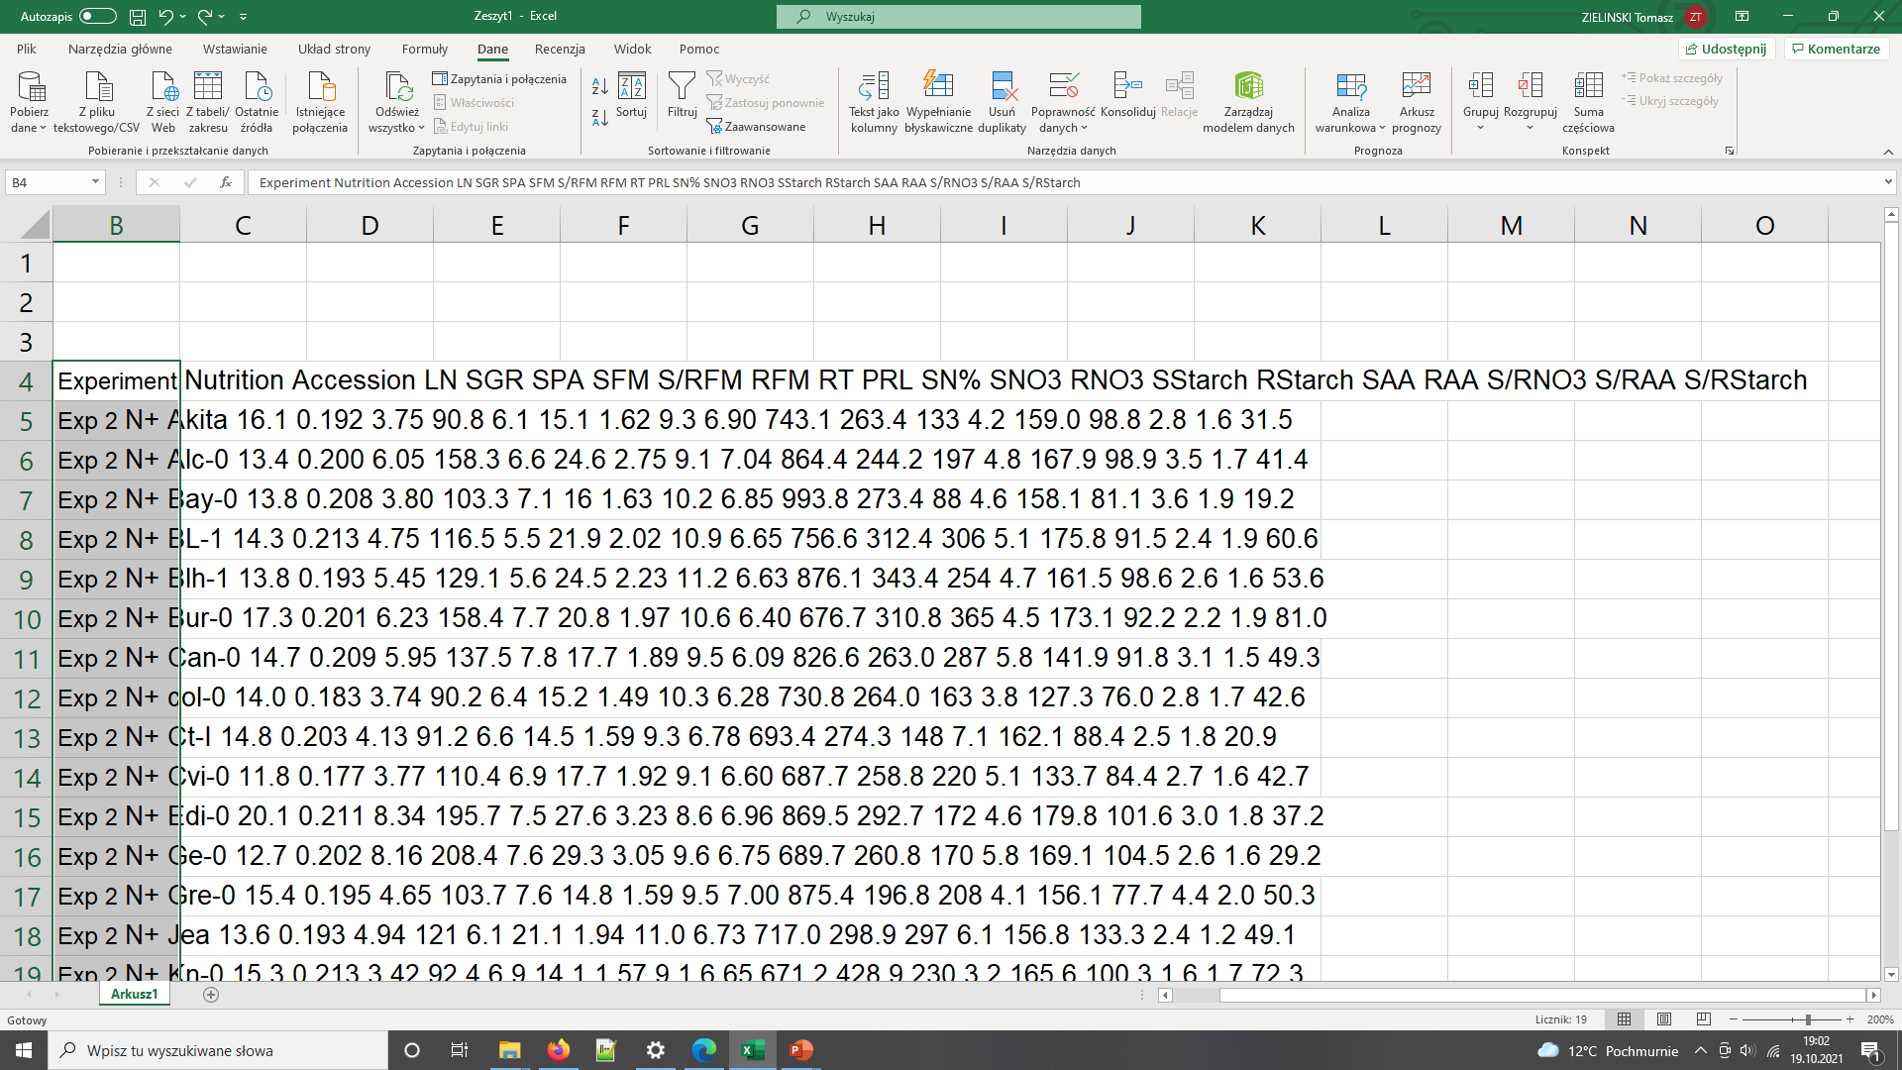
Impossible average

Slide 16
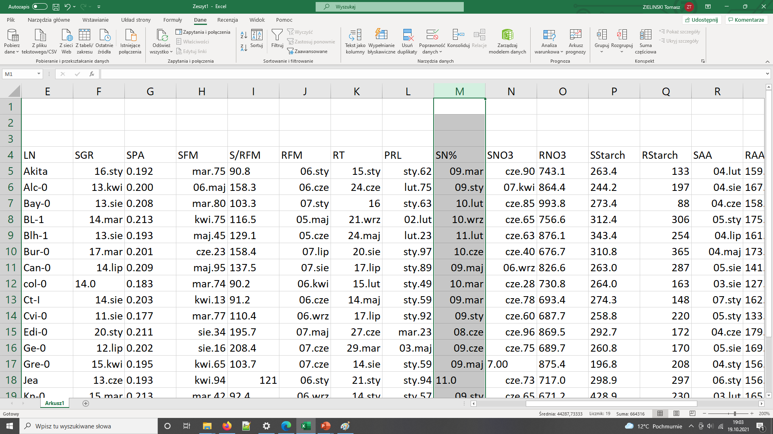
Impossible average

Slide 17
Common problems
The first example
the protocol was difficult to find (the loops),
the protocol difficult to access (pay wall),
and not reusable as it lacked the necessary details (dead-end).
The second example not interoperable and reusable
Numerical data as graphs / pdf
Obscure column headers

Slide 18
Common problems
Only averaged data available
No numerical data available
Data tables as PDF files in supporting information
Vendor specific file formats
Links to non existing group websites / databases
Data / Code “on request”

Slide 19

FAIR principles
CREDITS [5] CC BY

Slide 20
FAIR principles
Findable:
persistent identifiers pointing to the data
descriptions that allow discovery by both humans and computers
Accessible:
(meta)data retrieval by standard protocols (http)
metadata available even when the data are not
Interoperable:
(meta)data saved in open/common format (interpretable for various tools)
(meta)data should use vocabularies that follow FAIR principles.
Re-usable:
data should be well-described so that they can be replicated and/or combined in different settings
conditions of the reuse should be stated with a clear license

Slide 21
FAIR in biological practice
Findable & Accessible
Deposit data to an external, reputable public repository.
Repositories provide persistent identifiers (PIDs), catalogue options, advanced metadata searching, and download statistics. Some repositories can also host private data or provide embargo periods, meaning access to all data can be delayed.
There are general “data agnostic” repositories, for example: Dryad, Zenodo, FigShare, Dataverse and THE UNIVERSITY’s own DataShare .
Or domain specific, for example: UniProt – protein data, GenBank – sequence data, MetaboLights – metabolomics data.

Slide 22
FAIR in biological practice
Interoperable
Use .csv or .xls files for numerical data. Never share data tables as word or pdf
Provide underlying numerical data for all plots and graphs
Use common file formats (domain specific)
Convert proprietary binary formats to open ones. For example convert Snapgene to Genbank/SBOL, microscopy multistack images to OME-TIFF

Slide 23
FAIR in biological practice
Reusable
describe your data well (good metadata)
write a README file describing the data
provide as many details as possible (prepare good metadata)
use descriptive column headers for the data tables
tidy data tables, make them analysis friendly
use (meta)data formats (e.g. SBML, SBOL)
use commonly known terms and PIDs in descriptions
follow Minimum Information Standards
attach license files

Slide 24
FAIR and You
Citable
Track & Countable
Intelligible
Reproducible
CREDITS [5] CC BY

Slide 25
FAIR example
What makes it FAIR
https://doi.org/10.5281/zenodo.6339631
CREDITS [5] CC BY

Slide 26
Break

Slide 27
Metadata

Slide 28

What is data?
Biological data is diverse!
Data can be defined as facts, figures, or information that is collected, used and stored for reference or analysis
Information about physical samples:
animal/ plant (live, cell cultures, frozen tissues, etc)
patient information
bacterial / yeast stocks
Quantitative / numerical data: Spreadsheets (tables), csv files
Images (pictures, microscopy images, 3D scans)
Code (Software programs, analysis codes, algorithms)
DNA,RNA, protein sequences (plasmids, NGS sequencing files, etc)
Protocols (recipes, laboratory and measurement protocols)
Designed by Anindyanfitri / Freepik

Slide 29
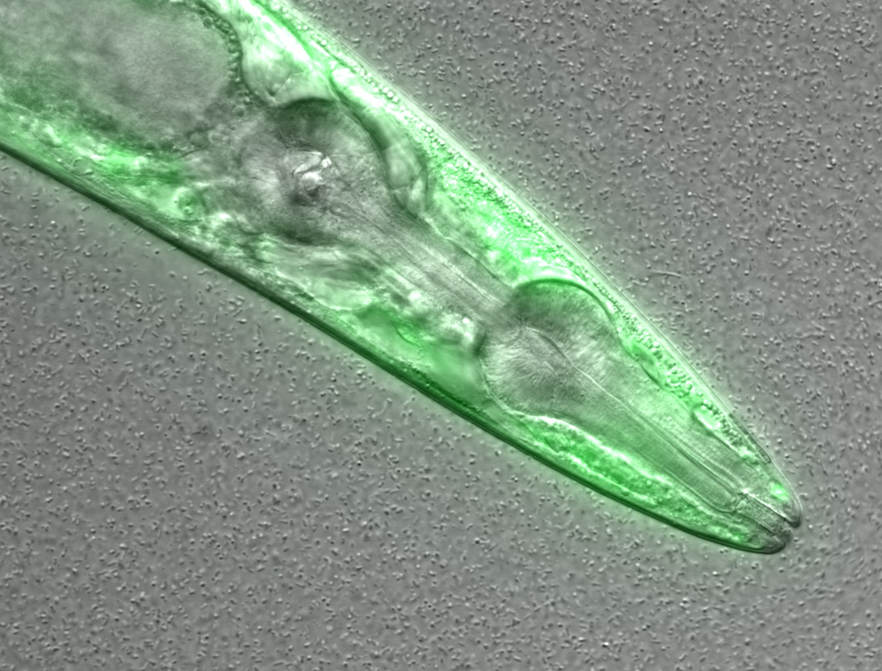
What information can you guess without the associated description (metadata)?
Figure credits: María Eugenia Goya
Notes:
Image metadata
Name: OP50 D10Ad_06.czi Image ID: 3485 Owner: Maria Eugenia Goya ORCID: 0000-0002-5031-2470
Acquisition Date: 2018-12-12 17:53:55 Import Date: 2020-04-30 22:38:59 Dimensions (XY): 1344 x 1024 Pixels Type: uint16 Pixels Size (XYZ) (µm): 0.16 x 0.16 x 1.00 Z-sections/Timepoints: 56 x 1 Channels: TL DIC, TagYFP ROI Count: 0
Tags: time course; day 10; adults; food switching; E. coli OP50; NL5901; C. elegans
Dataset metadata
Name: Figure2_Figure2B Dataset ID: 263 Owner: Maria Eugenia Goya ORCID: 0000-0002-5031-2470
Description: The datasets contains a time course of α-syn aggregation in NL5901 C. elegans worms after a food switch at the L4 stage:
E. coli OP50 to OP50 Day 01 adults Day 03 adults Day 05 adults Day 07 adults Day 10 adults Day 13 adults
E. coli OP50 to B. subtilis PXN21 Day 01 adults Day 03 adults Day 05 adults Day 07 adults Day 10 adults Day 13 adults
Images were taken at 6 developmental timepoints (D1Ad, D3Ad, D5Ad, D7Ad, D10Ad, D13Ad)
* Some images contain more than one nematode.
Each image contains ~30 (or more) Z-sections, 1 µmeters apart. The TagYFP channel is used to follow the alpha-synuclein particles. The TL DIC channel is used to image the whole nematode head.
These images were used to construct Figure 2B of the Cell Reports paper (https://doi.org/10.1016/j.celrep.2019.12.078).
Creation date: 2020-04-30 22:16:39
Tags: protein aggregation; time course; E. coli OP50 to B. subtilis PXN21; food switching; E. coli OP50; 10.1016/j.celrep.2019.12.078; NL5901; C. elegans

Slide 30

What is metadata?
Metadata is the data about data!
Description / information of the data
DATA
The data has little or no meaning without metadata
METADATA
It should be continuously added to your research data
(not just at the beginning or end of a project!)
Metadata plays a very important role in making your data FAIR
“Iceberg image designed by pikisuperstar / Freepik"

Slide 31
What information would you need to re-use that data?
Exercise 4
Suggestions:
Author
What it is
What was measured
Figure credits: María Eugenia Goya
Notes:
Image metadata
Name: OP50 D10Ad_06.czi Image ID: 3485 Owner: Maria Eugenia Goya ORCID: 0000-0002-5031-2470
Acquisition Date: 2018-12-12 17:53:55 Import Date: 2020-04-30 22:38:59 Dimensions (XY): 1344 x 1024 Pixels Type: uint16 Pixels Size (XYZ) (µm): 0.16 x 0.16 x 1.00 Z-sections/Timepoints: 56 x 1 Channels: TL DIC, TagYFP ROI Count: 0
Tags: time course; day 10; adults; food switching; E. coli OP50; NL5901; C. elegans
Dataset metadata
Name: Figure2_Figure2B Dataset ID: 263 Owner: Maria Eugenia Goya ORCID: 0000-0002-5031-2470
Description: The datasets contains a time course of α-syn aggregation in NL5901 C. elegans worms after a food switch at the L4 stage:
E. coli OP50 to OP50 Day 01 adults Day 03 adults Day 05 adults Day 07 adults Day 10 adults Day 13 adults
E. coli OP50 to B. subtilis PXN21 Day 01 adults Day 03 adults Day 05 adults Day 07 adults Day 10 adults Day 13 adults
Images were taken at 6 developmental timepoints (D1Ad, D3Ad, D5Ad, D7Ad, D10Ad, D13Ad)
* Some images contain more than one nematode.
Each image contains ~30 (or more) Z-sections, 1 µmeters apart. The TagYFP channel is used to follow the alpha-synuclein particles. The TL DIC channel is used to image the whole nematode head.
These images were used to construct Figure 2B of the Cell Reports paper (https://doi.org/10.1016/j.celrep.2019.12.078).
Creation date: 2020-04-30 22:16:39
Tags: protein aggregation; time course; E. coli OP50 to B. subtilis PXN21; food switching; E. coli OP50; 10.1016/j.celrep.2019.12.078; NL5901; C. elegans

Slide 32
What is metadata?
Adding metadata
Think as a consumer of your data not the producer!
What information would another researcher need to understand or reproduce your data?
Name of data creator/ Title
Project purpose and experimental hypothesis
Biological material, context, details on data acquisition, experimental conditions, etc.
+ Other datasets and publications associated to this image/ dataset (DOIs, links, etc).

Slide 33
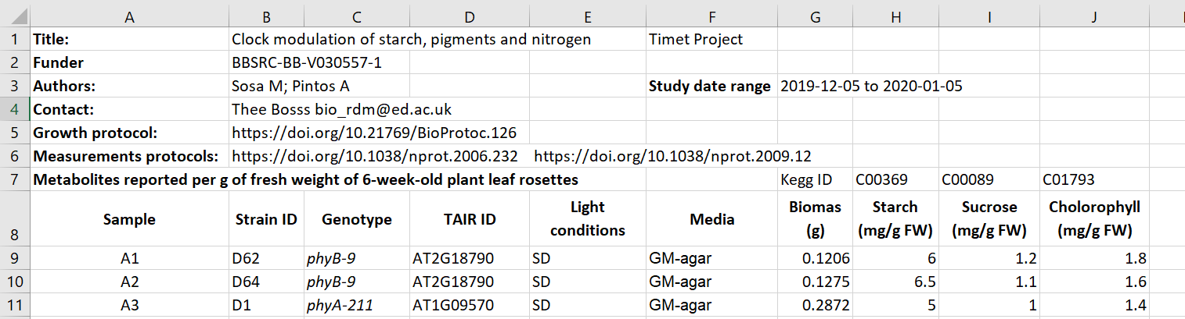
Metadata examples
Metadata embedded in spreadsheet
Figure credits: Tomasz Zielinski and Andrés Romanowski

Slide 34
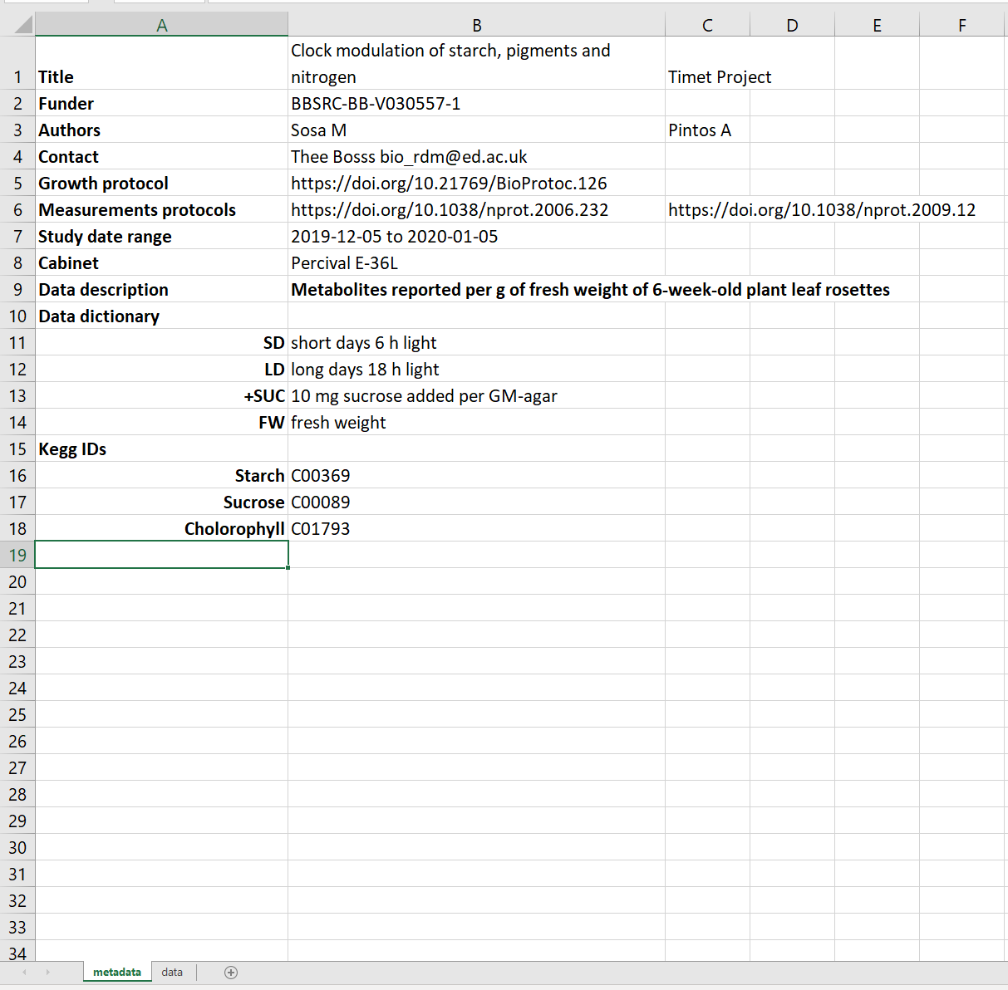
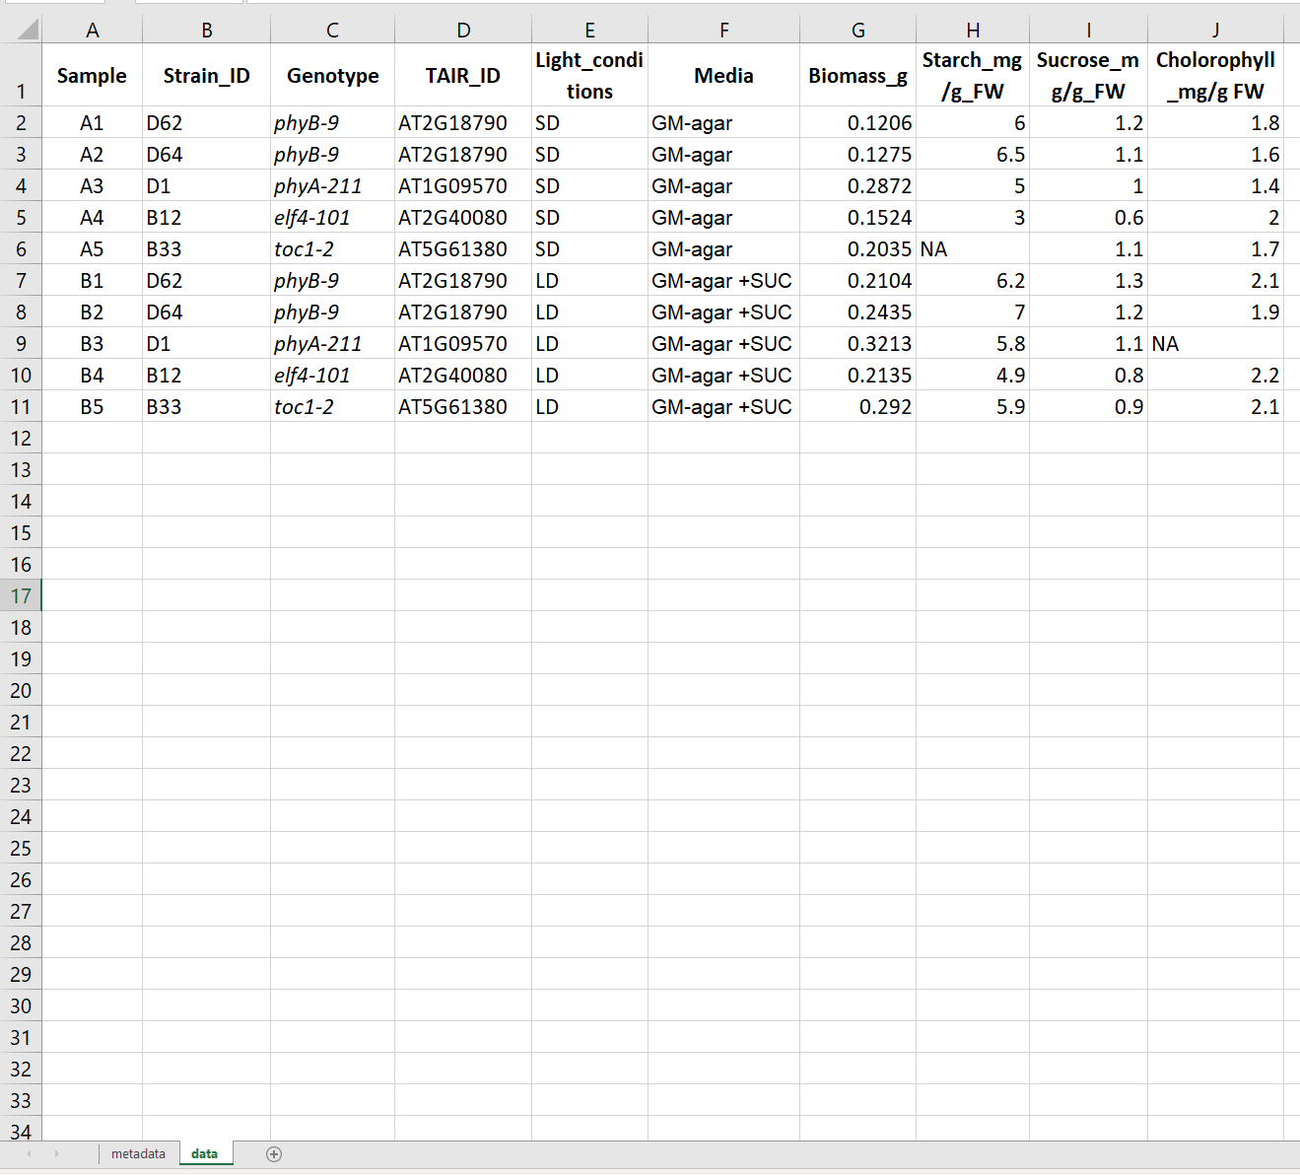
Metadata embedded in spreadsheet - better
A tab for metadata
A tab for data

Slide 35
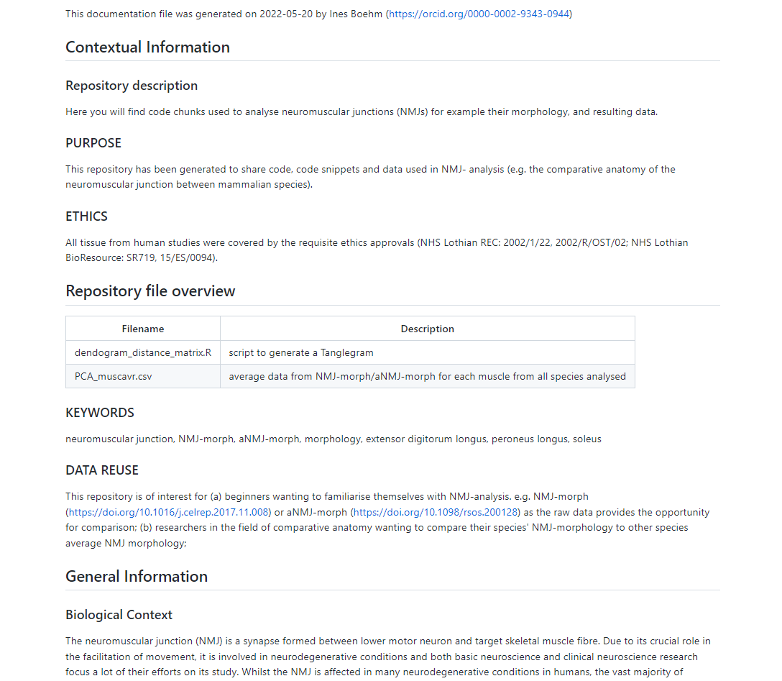
Metadata examples
Metadata as README file
https://github.com/Boehmin/NMJ_analysis/blob/main/README.md

Slide 36
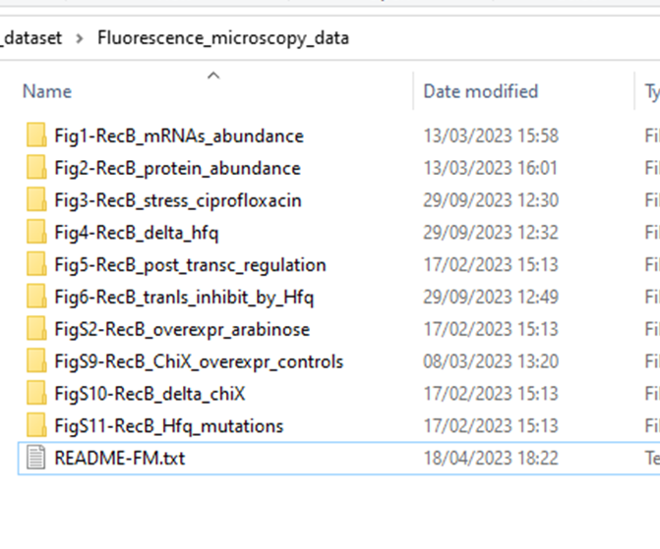
Metadata examples (tables or readme)
Metadata as README file

Slide 37
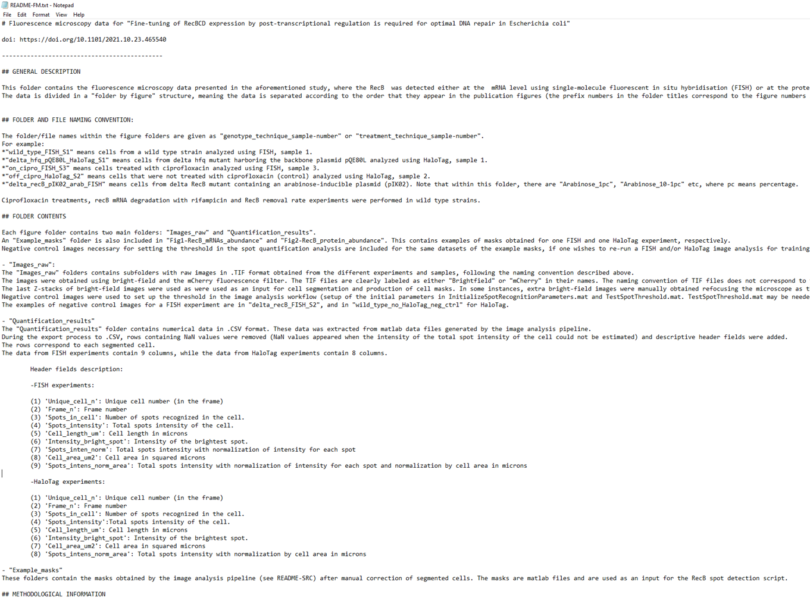
Metadata examples (tables or readme)
Metadata as README file

Slide 38
Record keeping:
Lab notebooks

Slide 39
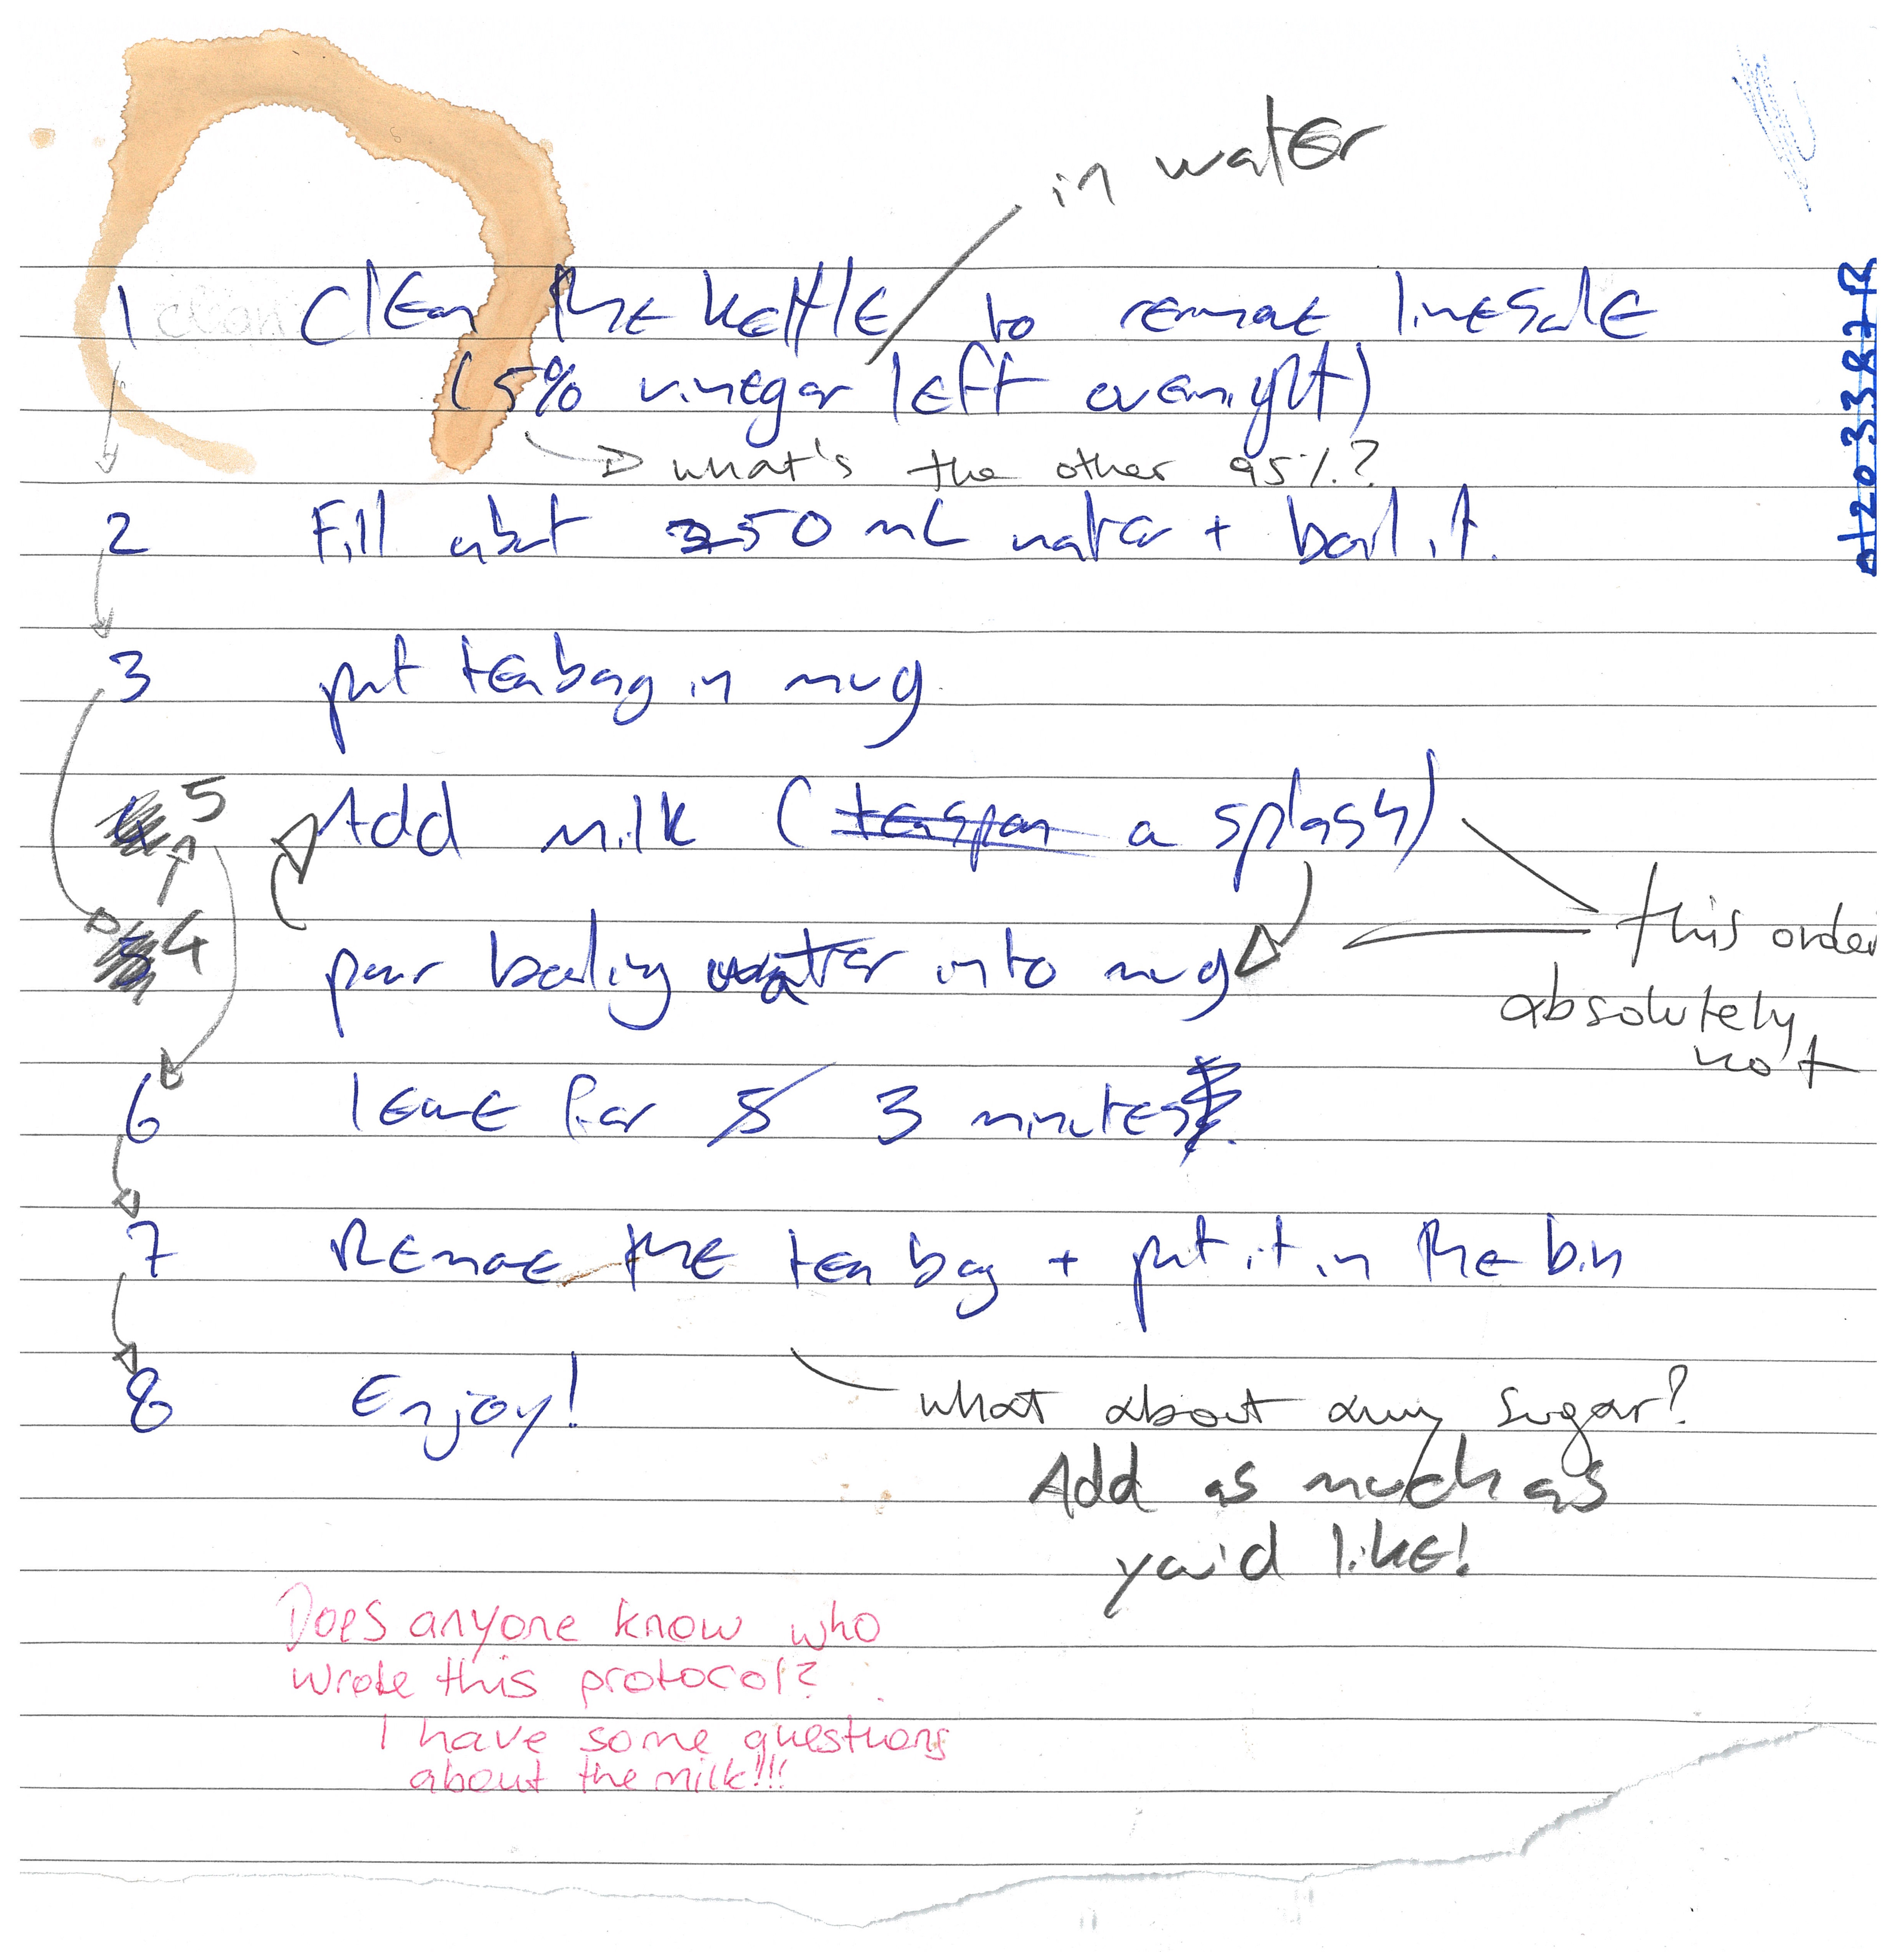
It is time to make ourselves a cup of tea.
Here’s a peer-reviewed protocol
for making tea
Figure credits: Dr Ines Boehm and Ben Thomas

Slide 40
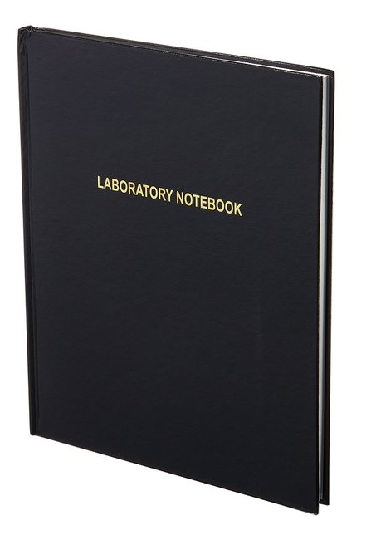
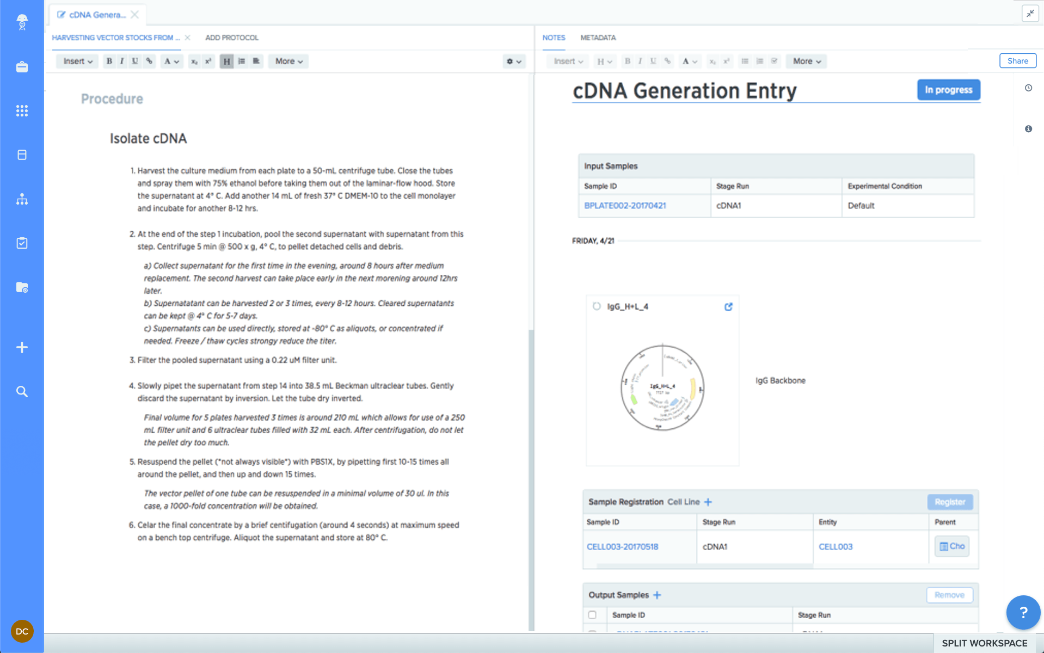
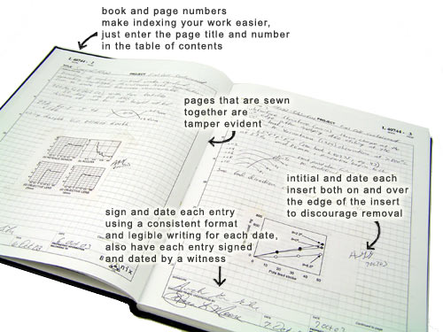
Paper vs Electronic lab notebook (ELN)
Exercise 5

Slide 41
Paper
ELN
Your data is organised and searchable​
Allows off-site archiving​
You can have templates (e.g.: protocols / assay / entries )​ - Easy to copy data entries
Can be shared instantly ; global access within a group​
Doesn’t take up physical space (no record rooms/folders)​
Regular backups​
does not require internet​
directly draw on your records​
Pros
​Can be lost or damaged​
Handwriting not always intelligible ​
Hard to edit and share​
Hard to reuse information​
Not findable/ accessible
Cons
Pros
Requires internet access​
Better if you have a gadget such as a tablet
Cons

Slide 42
Good Lab Records
Both protocols and laboratory records need to be detailed and kept accurate and complete.
Laboratory Notebooks
contain all relevant details (what, who, when why and how)
which project(s) is the record part of
information on lot/batch numbers
what happened and what did not happen (data, including images)
how you processed and analysed the data
your interpretation (and the interpretations of others if important) and next steps in the project based on these results
should be well organised for ease of navigation (indexed, labelled, catalogued)
accurate and complete: include all original data and important study details (metadata).
Protocols
who created the protocol if not you
complete and detailed instructions describing why and how to do an experiment
what special materials and instruments are being used and where they were obtained
health and safety advice and how to dispose of waste
allow repetition of your procedures and studies by yourself and others

Slide 43

Example of good record keeping
https://benchling.com/s/etr-0FdV1H0rpWeHk4H72NOg/edit
Aims of the experiment
Samples are described
Protocols are written down and referenced
Result figures and description
What worked and what did not; potential solutions
Final conclusions

Slide 44

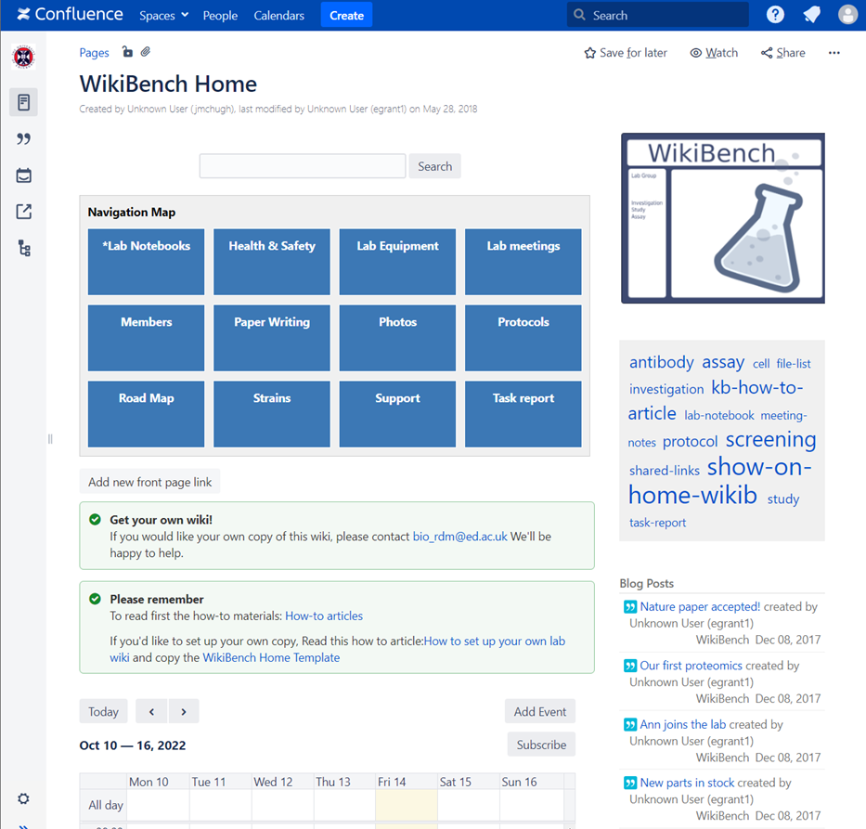



Which ELNs are used in SBS?
WikiBench (UoE Wiki)
For code
For keeping/sharing protocols
Notes:
The University of Edinburgh-hosted RSpace service benefits from integration with local infrastructure, allowing researchers to log in with their University login (EASE), link to files on DataStore, and archive data in DataShare.
The University has a discounted licence agreement with RSpace to provide the standard RSpace Enterprise edition.
LabArchives has a free version 1GB per user – with SnapGene & GraphPad Prism Integrations
Jupyter notebooks – very good for people who frequently use R or python scripts as it has an interface that integrates notebooks, code, and data. - Free

Slide 45
How do I choose an ELN?
Does my group already use one?
Yes
No
Use that one!
Things to take into account:
Cost
Traceable? (data cannot be deleted and are time stamped)
Where are the servers located?
Can the data be downloaded?
What happens to the data when someone leaves the group?
bio_rdm@ed.ac.uk​
Notes:
Acquire description at earlier stages, split over the stages

Slide 46


ELNs Resources from BioRDM
https://www.wiki.ed.ac.uk/x/f0SkGw
Hands-on tutorial on Benchling:
https://www.wiki.ed.ac.uk/display/RDMS/Benchling+tutorial+and+resources
bio_rdm@ed.ac.uk​
Notes:
Acquire description at earlier stages, split over the stages

Slide 47
Working with files

Slide 48
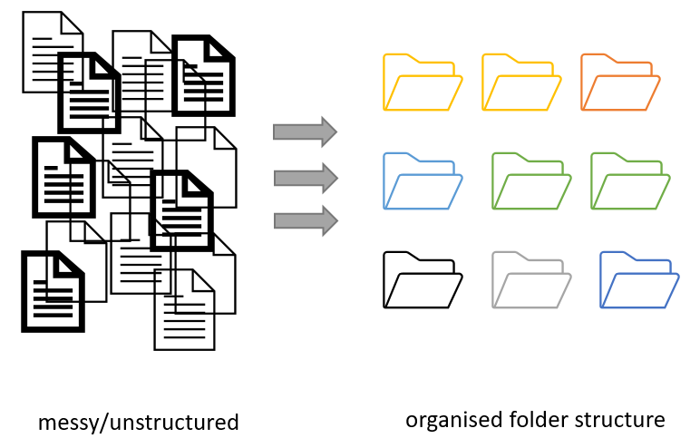
Project organization
Figure credits: Andrés Romanowski

Slide 49
Consistent naming and organization of files in folders has two main goals:
Find files quickly
Ability to tell the file content without opening it

Slide 50
It is important to develop standardized, naming convention
consistent
encoding of experimental factors
meaningful to you and your collaborators
give you a sense of the content
easily identify if something is missing

Slide 51
Naming files
Do’s:
Include date in the name. Use ISO format: YYYY-MM-DD or YYYYMMDD
e.g. 20241106 Add date at the end of the file UNLESS you organize files chronologically
Include version number (if applicable) (orthogonal to date) Use leading zeroes (i.e.: v005 instead of v5)

Slide 52
Naming files
Do’s:
Encode biological or experimental relevant information, concisely, data category, etc. Example information to include:
sample, site, patient id
drug treatments, doses, names
environmental conditions
genotypes, markers,
technique
Data operation: normalized, cleaned, detrended, clustered

Slide 53
Naming files
Example name:
LD_phyA_off_t04_2020-08-12_norm.xlsx
is a file that:
from experiment in long day (LD)
for genotype phyA
with media without sucrose (off)
at timepoint 4 (t04)
normalized data (norm),

Slide 54
Naming files
Do’s:
Add leading zeros to numerical values
Add prefixes to numerical values: eg. S003, TR005

Slide 55
Naming files
Do’s:
Make sure the file format extension is present at the end of the name (e.g. .docx, .xlsx, .mov, .tif)
Add a PROJECT_STRUCTURE (README) file in your top directory which details your naming convention, directory structure and abbreviations

Slide 56
Naming files
Don'ts:
Avoid using spaces (use _ or - instead)
Avoid using commas and special characters (e.g. ~ ! @ # $ % < > ?[ ] { } ‘)
Avoid using language specific characters (e.g óężé)

Slide 57
Naming files
Don'ts:
Avoid using long names (should not exceed 30 characters)
Avoid repeating information from parent elements ELN_MI_20200101.tiff in Electron_Microscopy folder
Avoid using deep paths with long names (i.e. deeply nested folders with long names)

Slide 58
Exercise 6:
A good name

Slide 59
Folders vs Files
Folders permit grouping relevant data together
Folders help to keep files names short

Slide 60
Exercise 7:
Folders vs Files

Slide 61

Exercise 7
A)
Datasets for publication (grouped by raw data, results, scripts)
Pipelines (inputs, outputs, scripts and workflow)
B)
„By Figure” or „By analisys” – data and related code next to each other
C)
„By patient” (sample/subject) ... based on Brain Imaging Data Structure BIDS
D)
„By conditions/treatment” – mulitple biological materials under various experimental conditions

Slide 62
Break

Slide 63
Sharing as part of the workflow
CREATING DATA
RE-USING DATA
PROCESSING DATA
Time and effort
SHARING
DATA
ANALYSING DATA
PRESERVING DATA
work necessary to make outputs suitable for sharing

Slide 64
Sharing as part of the workflow
CREATING DATA
RE-USING DATA
PROCESSING DATA
Time and effort
SHARING
DATA
ANALYSING DATA
PRESERVING DATA
work necessary to make outputs suitable for sharing
standard research operations

Slide 65
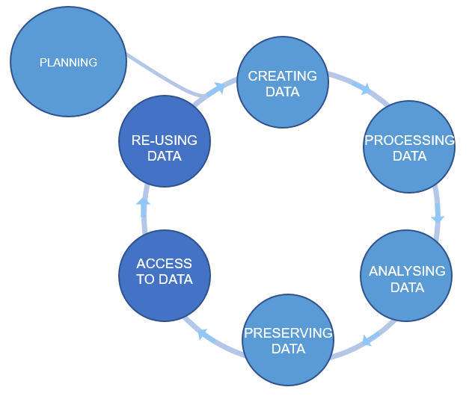

Plan ahead
Data management plans
(DMPs)
Figure credits: Tomasz Zieliński and Andrés Romanowski

Slide 66
Data Management Planning: What? How? Where?
What: thinking what data you will generate
Types of data, format, volume of the data
How: thinking about how you will
Organise, describe, securely store, and back your data up
Where: to ensure your data is available for replication re-use:
archiving, publishing, conditions of re-use
Notes:
How manage: organise, document, store, back-up.
How share and preserve: make data available for verification, replication, re-use.
Plan to prevent loss: HD failure, accidental delete, cat peeing on laptop.
Plan to prevent unauthorised access of sensitive/personal data.
DMPOnline:
Funder Templates
Plan broken down into sections:
data creating/collecting: size, format, type
documentation and metadata
quality assurance processes/standards
storage and back up plans
security measures for sensitive data
how, where, when share it (on publication)
how preserve
Includes lots of guidance for each section : funders / UoE /Data Curation Centre.

Slide 67
Writing a DMP for your Research
Tool: DMPOnline https://dmponline.ed.ac.uk
RDS Hands-on workshop(s)
Understand the necessity/benefits of producing a DMP
Discover how to register for and use DMPonline
Draft a basic DMP!
https://library.ed.ac.uk/research-support/research-data-service/research-data-training-skills/workshops-courses

Slide 68
BioRDM DMP advice
https://www.wiki.ed.ac.uk/display/RDMS/Data+Management+Plans

Slide 69
Your musts According to policies (the School, the University and the funders):
You are responsible for safety of your data (both storage and access)
Back up (almost) everything created by a human or recorded by a machine as soon as it is created.
USB sticks are a failure-prone option and are not a valid solution for backup of scientific data
Always backup your files in 3 places, at least one should be off-site.
A robust backup cannot be achieved manually – the University gives you DataStore

Slide 70
Your musts According to policies (the School, the University and the funders):
You need a DMP for your project
You have to publish Open Access
You have to make available all the data underlying publications

Slide 71
You want to
Have as many public outputs as possible:
Datasets in public repositories
Public protocols
Code packages
Public engagement
Involvement in community groups, student groups etc
(BioPod, Doors Open Day, Festivals, etc)
for your Narrative CVs

Slide 72

Declaration on Research Assessment
the need to eliminate the use of journal-based metrics, such as Journal Impact Factors, in funding, appointment, and promotion considerations;
the need to assess research on its own merits rather than on the basis of the journal
the need to capitalise on the opportunities provided by online publication (such as relaxing unnecessary limits … exploring new indicators of significance and impact)
https://sfdora.org/read/

Slide 73
“For the purposes of research assessment, consider the value and impact of all research outputs (including datasets and software) in addition to research publications, and consider a broad range of impact measures including qualitative indicators of research impact, such as influence on policy and practice”
https://sfdora.org/read/

Slide 74
Narrative CVs are comming
Generation of Knowledge
Development of Individuals and Collaborations
Supporting Broader Society and the Economy
Supporting the Research Community

Slide 75
Narrative CV
A broad definition of ‘output’ is used, such as datasets, patents and software.
Special attention is paid to Open Science and openly available outputs.
New metrics: retweets, online views and downloads, discussions, presence in mass media technology platforms

Slide 76
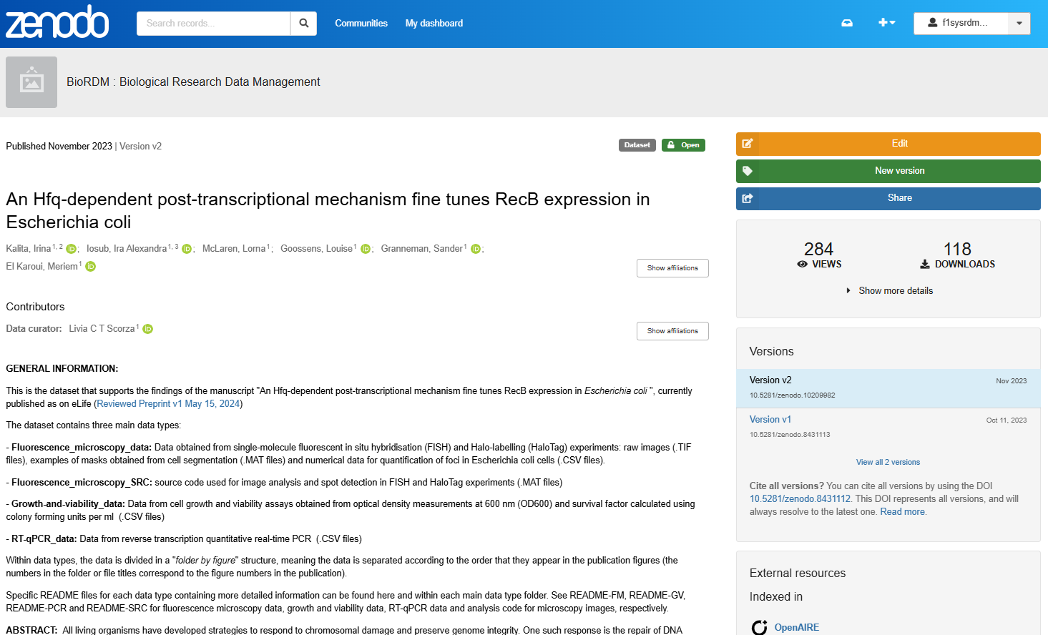
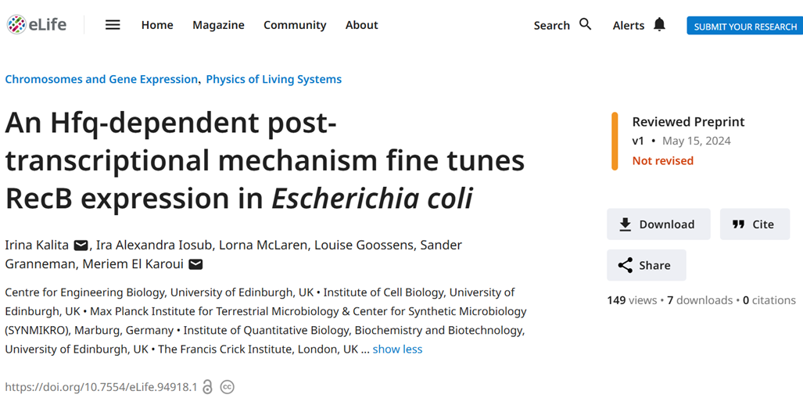
Dataset
Publication

Slide 77
It is easier to be prepared than to fake it
It takes time to make the outputs public
The quality of open outputs is easy to assess
Timestamps

Slide 78
Research culture
Learn what your group does (or does not) and why
Remember many early adopters got burnt
Do not be complicit in bad practices
Trigger change by example
Look for help (BioRDM, PhD advisors)

Slide 79
Resources for data management
BioRDM wiki
https://www.wiki.ed.ac.uk/display/RDMS
RDS page
https://www.ed.ac.uk/information-services/research-support/research-data-service
DRS page
https://digitalresearchservices.ed.ac.uk/
DataStore
• https://www.ed.ac.uk/information-services/computing/desktop-personal/connect-uni-file-storage
• https://www.wiki.ed.ac.uk/x/tet_H
Sharepoint
https://uoe-my.sharepoint.com
UoE WIKI
https://www.wiki.ed.ac.uk
DMPOnline
https://dmponline.dcc.ac.uk
Jupyter notebook
https://jupyter.org/
Benchling
https://www.benchling.com/
Protocols.io
https://www.protocols.io/
Zenodo
https://zenodo.org/
UoE DataShare
https://datashare.is.ed.ac.uk/
FAIRification of you project (FAIR cookbook)
https://faircookbook.elixir-europe.org/
FAIR in (bio) practice
https://carpentries-incubator.github.io/fair-bio-practice/
Github/ GitLab
https://github.com/
https://git.ecdf.ed.ac.uk/
Version control with Git - self paced course
https://swcarpentry.github.io/git-novice/

Slide 80
Quiz and the feedback at the end of the pad

Slide 81

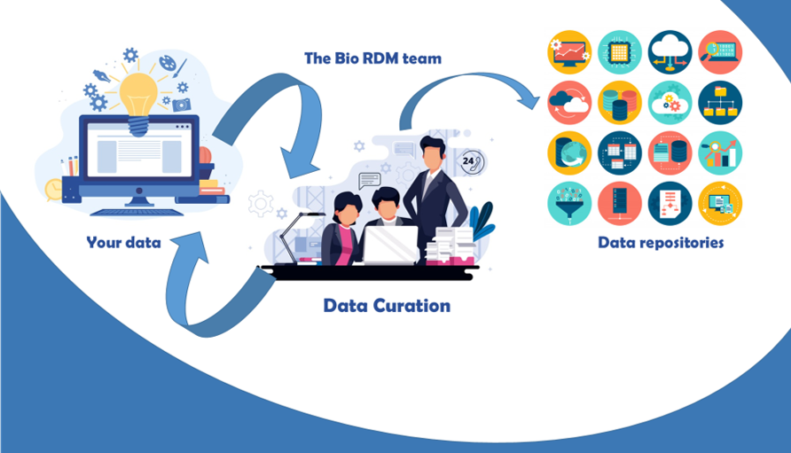
Need help? Just come talk to us!
Biological Research
Data Management Team
RDM as part of the workflow
bio_rdm@ed.ac.uk
https://www.wiki.ed.ac.uk/display/RDMS/
Notes:
Acquire description at earlier stages, split over the stages

Slide 82
University resources for data management
BioRDM wiki
https://www.wiki.ed.ac.uk/display/RDMS
(demo)
RDS – Research data service page
https://www.ed.ac.uk/information-services/research-support/research-data-service
DRS page – Digital research services
https://digitalresearchservices.ed.ac.uk/

Slide 83
University resources - Storage
UoE DataStore
it looks like your computer disk (a network drive)
free (250GB + 250GB per student)
accessible from all computers
off-site backup and versioning/history of the files
easy sharing within the University
Dropbox like access vis DataSync
https://library.ed.ac.uk/research-support/research-data-service/during/data-storage

Slide 84
University resources - Storage
UoE DataStore
it looks like your computer disk (a network drive)
free (250GB + 250GB per student)
accessible from all computers
off-site backup and versioning/history of the files
easy sharing within the University
Dropbox like access vis DataSync
Please Use DataStore
https://library.ed.ac.uk/research-support/research-data-service/during/data-storage

Slide 85
University resources - Storage
UoE DataStore - using
Two areas
Group space (\\csce.datastore.ed.ac.uk\csce\biology\groups\YOUR-GROUP)
Private (\\csce.datastore.ed.ac.uk\csce\biology\users\YOUR_LOGIN)
Use group space for data!

Slide 86
University resources - Storage
UoE DataStore - using
You need VPN to connect from home
Depending on network speed, using it may be tricky for very large files
Instructions how to use:
https://www.ed.ac.uk/information-services/computing/desktop-personal/connect-uni-file-storage
BioRDM wiki (recipes for difficult use-cases)

Slide 87
University resources - Collaboration
Sharepoint / OneDrive (1TB)
https://uoe-my.sharepoint.com
For documents, presentations, reports, etc.
Excellent for collaborative work on shared documents
Online versions of Word / Excel
Your desktop office can directly sync with sharepoint files
DON’T bounce emails with your PI – co-edit on sharepoint!!!

Slide 88
University resources - Collaboration
UoE WIKI
https://www.wiki.ed.ac.uk
projects’ websites,
making notes, organizing files,
even a simple ELN
(can be private or public)
https://www.wiki.ed.ac.uk/display/RDMS

Slide 89
University resources - protocols
Protocols.io (UoE subscription to protocols.io will end Dec2024)
https://www.protocols.io/
private and public (creates DOI) – free version – 2 private protocols
versioning / forking
collaboration
good for group SOPs
Notes:
On the 31st December 2024 our subscription to protocols.io will end and we have taken the difficult decision not to renew it. The reason for this is that in 2023 the company that developed protocols.io sold it to the academic publisher Springer Nature and they have decided to impose an increase in subscription cost of over 700% for 2025.

Slide 90
University resources - CODE
If you code (script) you should use GIT
(you need to learn it though)
Free github (https://github.com)
The University one (https://git.ecdf.ed.ac.uk)

Slide 91
University resources - repositories
Choosing domain specific repository
BioRDM wiki
Fairsharing.org

Slide 92
University resources - repositories
UoE DataShare
https://datashare.ed.ac.uk/
for sharing public datasets (possible embargo period)
unlimited, free storage (250GB per dataset)
DOI
automatically creates records in your personal profile (UoE PURE)

Slide 93
University resources - information
RDS page
https://www.ed.ac.uk/information-services/research-support/research-data-service
BioRDM wiki
https://www.wiki.ed.ac.uk/display/RDMS
(demo)

Slide 94
Learning
Practical recipes and guides:
https://faircookbook.elixir-europe.org/
https://rdmkit.elixir-europe.org/
Training
Ed-DASH https://edcarp.github.io/Ed-DaSH/index.html
UoE RDS https://www.ed.ac.uk/information-services/research-support/research-data-service

Slide 95
FAIR in (bio) practice - workshop
Introduction to Open Science and FAIR
IP, Licensing and Openness
Metadata
Ontologies
(Meta)data in Excel
Record keeping
Working with files
Reusable analysis - Jupyter
Version control
Templates
Public repositories
Writing Data Management Plans

